Slide 1

Reverse Engineer Android APKs and Auto-Modify Permissions/UI Strings
Final Project Review Presentation

Slide 2
Project Overview
Goal: Reverse engineer Android APKs to modify dangerous permissions and UI strings automatically.
Tools used: Apktool, Python, Bash scripting, Linux environment.
Automation of tedious manual security analysis tasks.

Slide 3
Problem Statement
Many apps request unnecessary or dangerous permissions.
Manual decompilation, modification, and rebuilding of APKs is error-prone and time-consuming.
Need for an automated, repeatable, and safe process.

Slide 4

Proposed Solution
Decompile APKs using Apktool.
Analyze and modify AndroidManifest.xml and UI layout XML files.
Replace or remove strings, hide unwanted elements, and reduce app permissions.
Rebuild and sign the APK automatically.

Slide 5
Architecture and Workflow
Input: Original APK
Process: Decompile → Modify → Rebuild → Sign
Output: Cleaned APK ready for testing or distribution

Slide 6
Technologies Used
Apktool: for decompilation and rebuilding
Python: for automated XML string modification
Bash: to automate end-to-end flow
Keytool and Jarsigner: for signing APKs

Slide 7
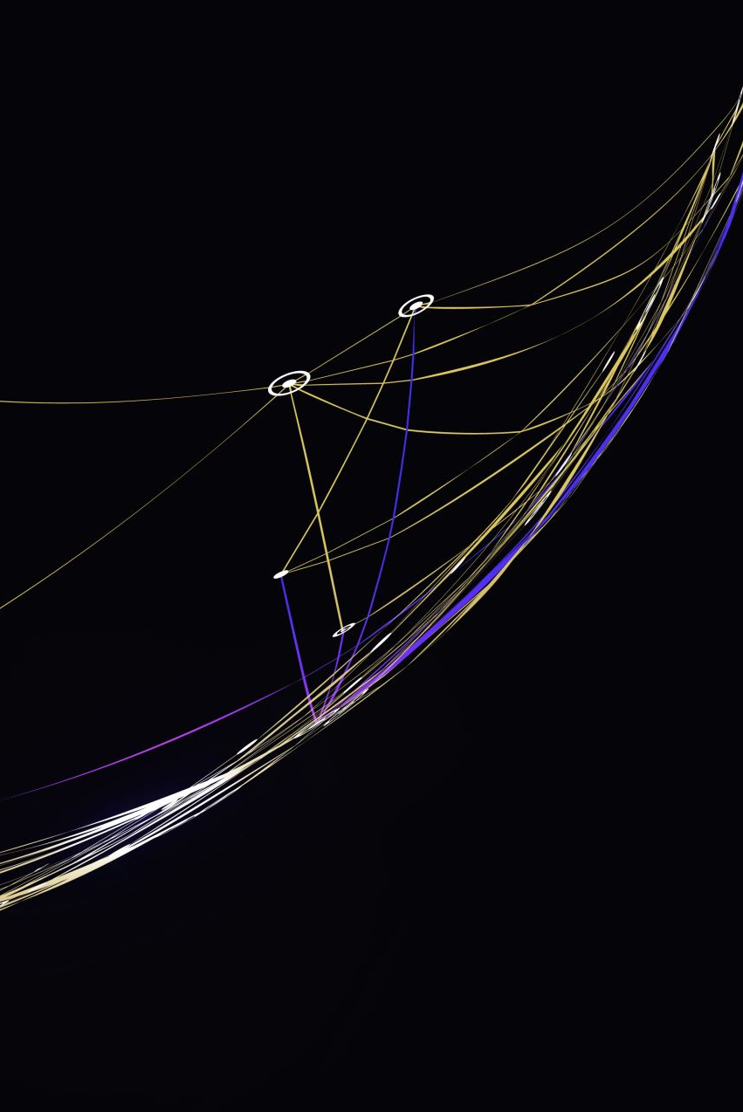
Challenges Faced
Maintaining app functionality after modification
Ensuring compatibility across different Android versions
Correctly identifying and modifying embedded strings

Slide 8

Demo & Results
Before: App had excessive permissions and distracting UI strings.
After: Minimal permissions retained, UI elements cleaned.
Output: Rebuilt APK installs and runs correctly with safer defaults.

Slide 9

Real-World Use Cases
App security auditing and parental control
Open-source app rebranding and privacy preservation
Compliance with custom device policies

Slide 10

Future Scope
Integrate ML to detect dangerous permissions.
Add GUI for better usability.
Support batch processing of multiple APKs.

Slide 11

Thank You
Any Questions?
By : Sai Datta Badam

